Slide 1

Analytics Case Assignment Fraud Detection Medicare Claims Dataset
Hoang Nha Nguyen

Slide 2
WHY ?
US Healthcare spending has increased.
Issues facing healthcare such as fraudulent or potentially fraudulent physicians or providers.
High-cost health related services leave patients with limited medical care .US has established and funded programs such as Medicare

Slide 3
Workflow
01
Database Selection
CMS Medicate Dataset (2012-2015)
Test Data Fraud Claims
Excluded (LEIE) dataset
Target variable: Fraud_Label (Yes/No)
02
Data Pre-processing
Exploratory Data Analysis
Data cleaning
Feature Engineering
03
Logistic Regression
Random Forest Classifier
Data Modelling
04
End Result
Model Evaluation

Slide 4
Goal
Develop a classifier model with certain features that can help detect fraud.
Target variable: Fraud_Label (Yes/No)

Slide 5
Dataset Selection
01
List of individuals and entities excluded from Medicare due to previous healthcare fraud.
Filter unique NPI (remove all null values)
List of Excluded Individuals and Entities (LEIE) database 2017
02
CMS Dataset (2012-2015)
All information related to physicians and their payments, charges by NPI.
Join these input data (2012-2015)
03
A test dataset with a smaller number of providers
Test data fraud claims

Slide 6
Data Pre-processing
Join ”LEIE” and “CMS” datasets by “Fraud_Label”. Remove all duplicate values
Remove all null values in all columns - ie: “Last name/ Organization name”, “HCPCS Code”
Export final output - ”All_claims_data” dataset – 8982 rows, 30 fields
Correcting the data types of all variables

Slide 7
Feature Engineering
Perform necessary transformations on the custom formulas/variables
Total_amount_claimed -> Sum
Total_amount_paid -> Sum
Total_amount_allowed ->Sum
Payout-ratio -> Average
Allowance ratio -> Average
Final_amount_received -> Average
Excess_amount_claimed -> Average
Number of medicare -> Average
HCPCS -> Count
Group by the following columns – “NPI”, “Gender”, “Provider Type”

Slide 8
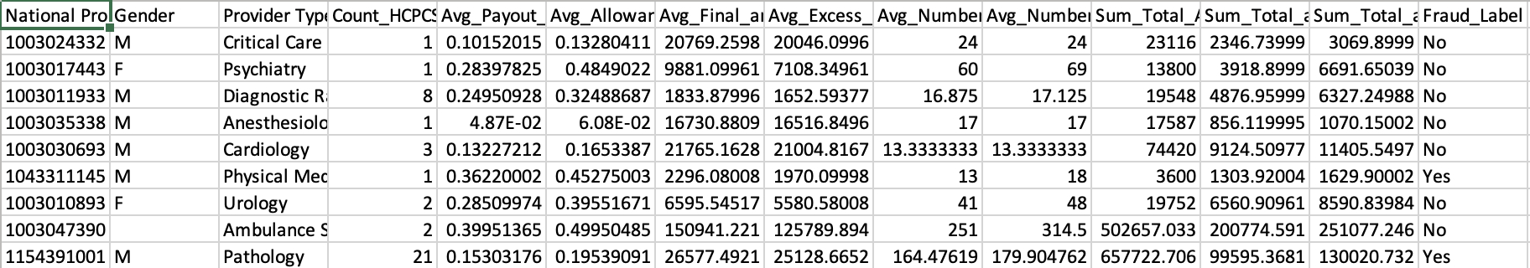
Final Dataset: “Physician_level_aggregate”
292 rows, 14 fields -> “Fraud_Label” Y/N

Slide 9
T-Test (Statistical Significance Test 5%)
Variables | P-Values
Avg_Payout_ratio | 7.7717e-06
Avg_Allowance_ratio | 6.8443e-07
Avg_Final_amount | 0.9049
Avg_Excess_Amount | 0.76564
Sum_Total_Amount_Claimed | 0.046566
Sum_Total_Amount_Paid | 0.0023565
Sum_Total Amount Allowed | 0.0018021
Avg_Number_Medicare.Beneficiaries | 0.028824
Avg_Number_Medicare.Beneficiaries.Day.Services | 0.069605
Count_HCPCS | 0.00063374
Statistically significant variables:
“Avg_Payout_Ratio”
“Avg_Allowance_ratio”
“Sum_Total_Amount_Claimed”
“Sum_Total_Amount_Paid”
“Sum_Total_Amount Allowed”
“Avg_Number_Medicare.Beneficiaries”
“Count_HCPCS”
Transform skewed data to approximately conform to normality by using log transformation
Class weights assigned to reduce skewness according to the balancing ratio

Slide 10
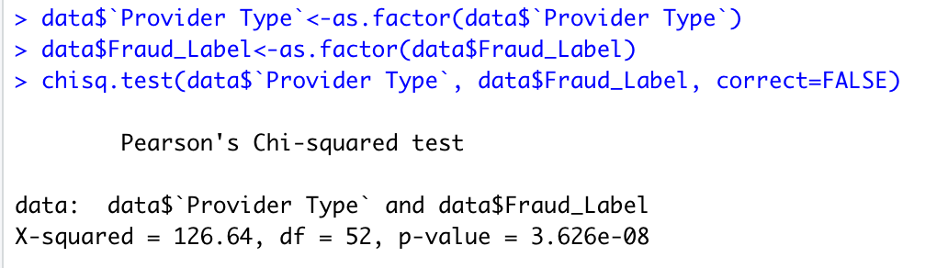
Chi-squared Test
Transform skewed data to approximately conform to normality by using log transformation
“Provider Type” is statistically significant
Class weights assigned to reduce skewness according to the balancing ratio

Slide 11
Features Selection
Significant variables:
“Avg_Payout_Ratio”
“Avg_Allowance_ratio”
“Sum_Total_Amount_Claimed”
“Sum_Total_Amount_Paid”
“Sum_Total_Amount Allowed”
“Avg_Number_Medicare.Beneficiaries”
“Count_HCPCS”
“Provider Type”
Also, there is no need to consider the following variables for the model:
“NPI” and “Gender”

Slide 12
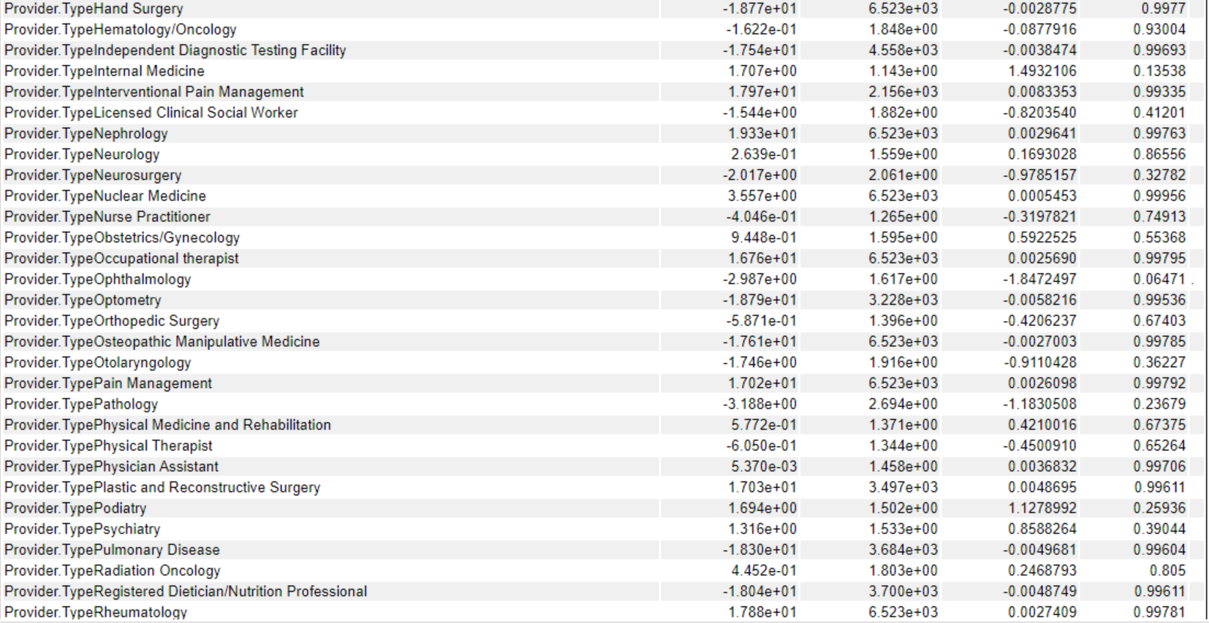
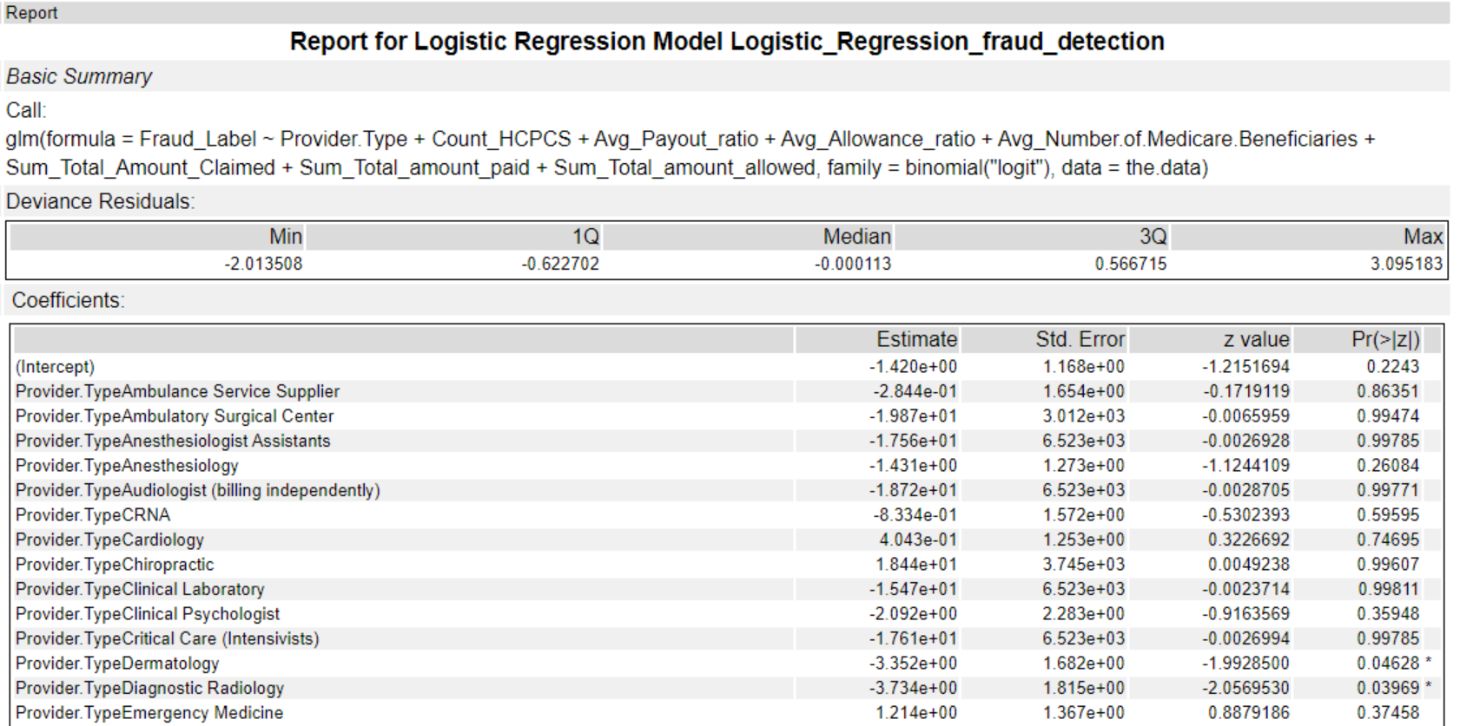
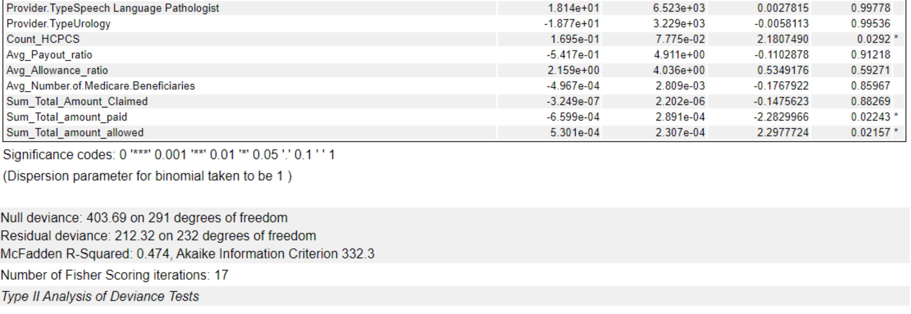
Model 1 Logistic Regression

Slide 13
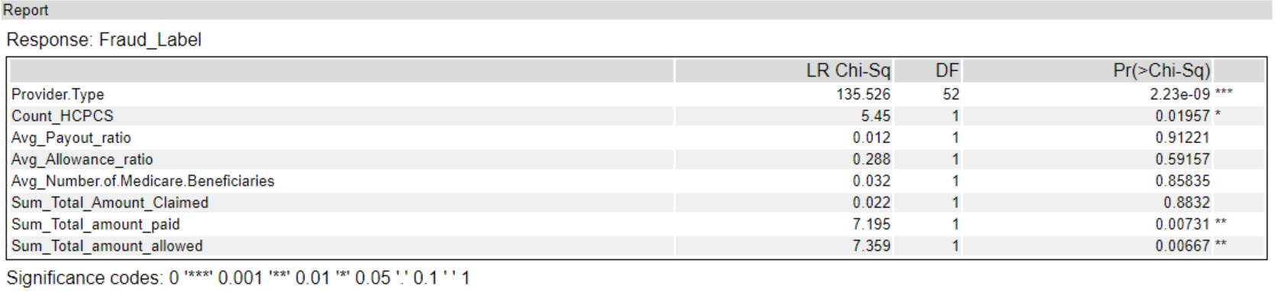
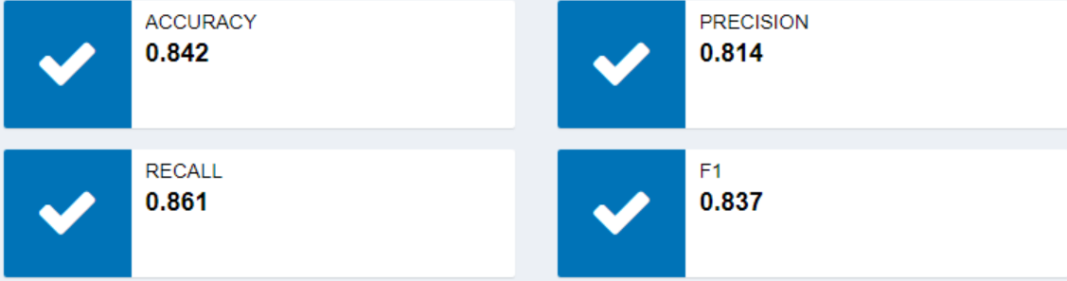
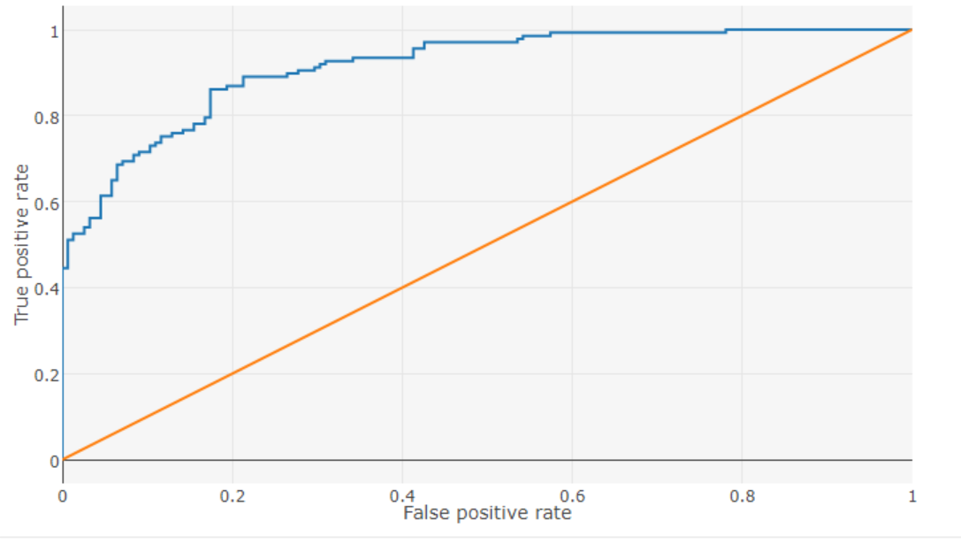
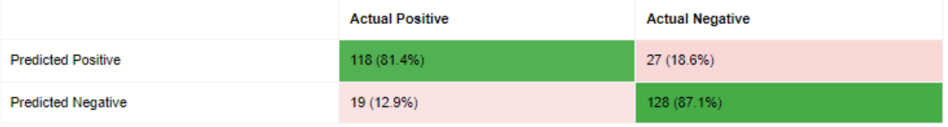
Model Evaluation
Logistic Regression

Slide 14
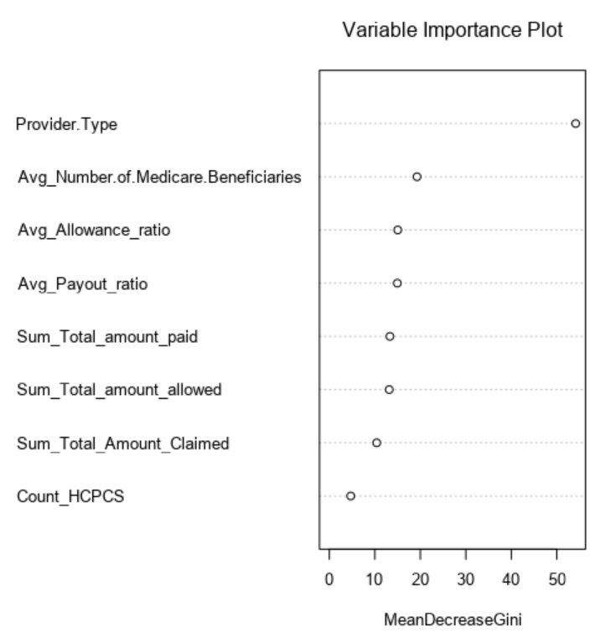
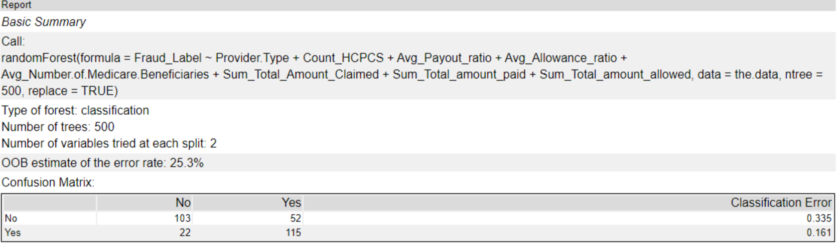
Model 2 Random Forest

